Slide 1


Human Resource
Management
H R M
By: Talal Alrashidi

Slide 2
Introduction
My application is based on employee service and human resource management, which makes their professionalism and speed of completion of tasks and requirements, saving paper and increasing employee productivity.

Slide 3
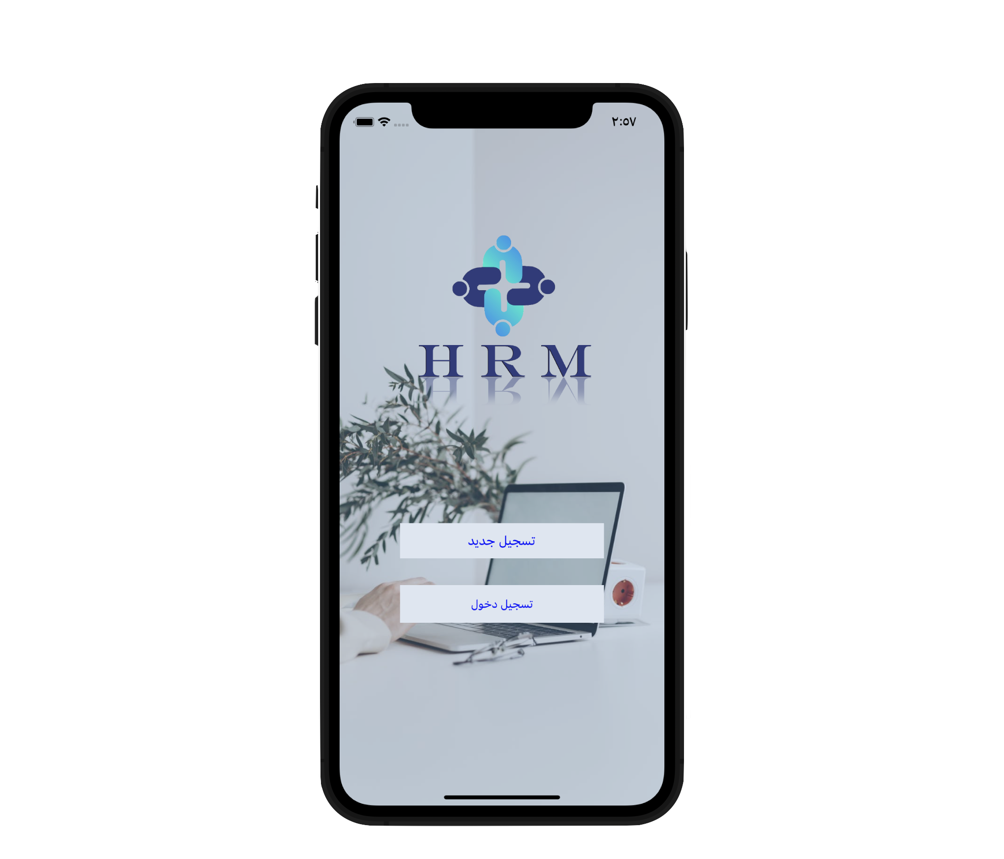
Description
- Project will serve employees and HR .
- All staff can create account by email .
- HR as account have user , employee as account have user to joining App! .
- All users in first page have profile .
- Employee can make a request of what he wants from HR office .
- once HR staff join the app will check all the requests .

Slide 4
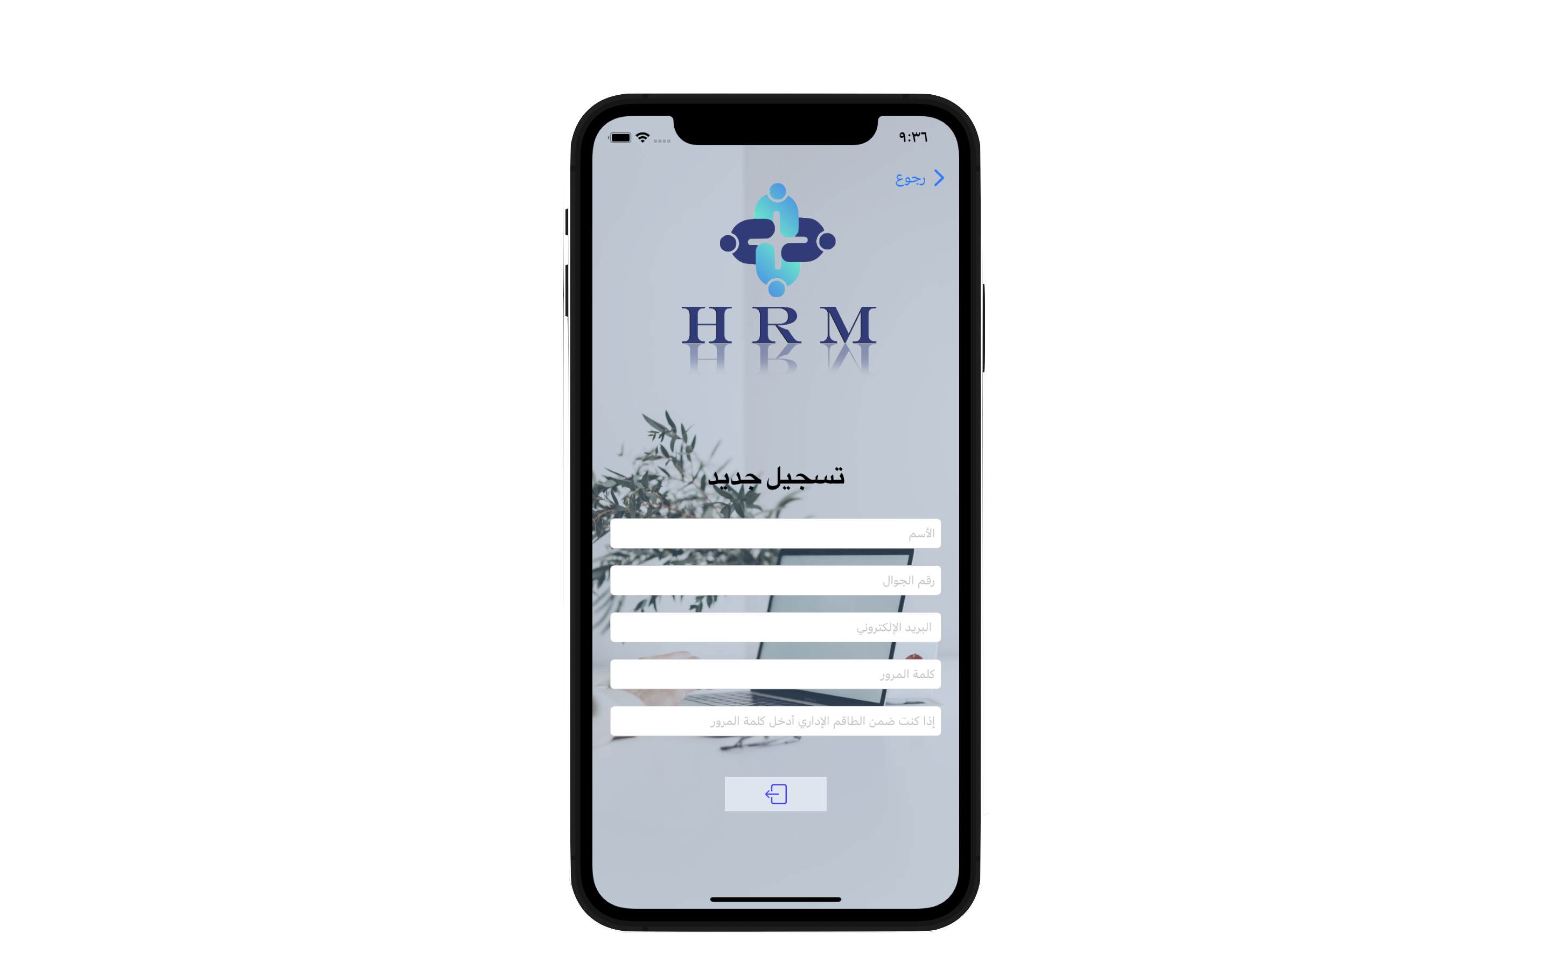
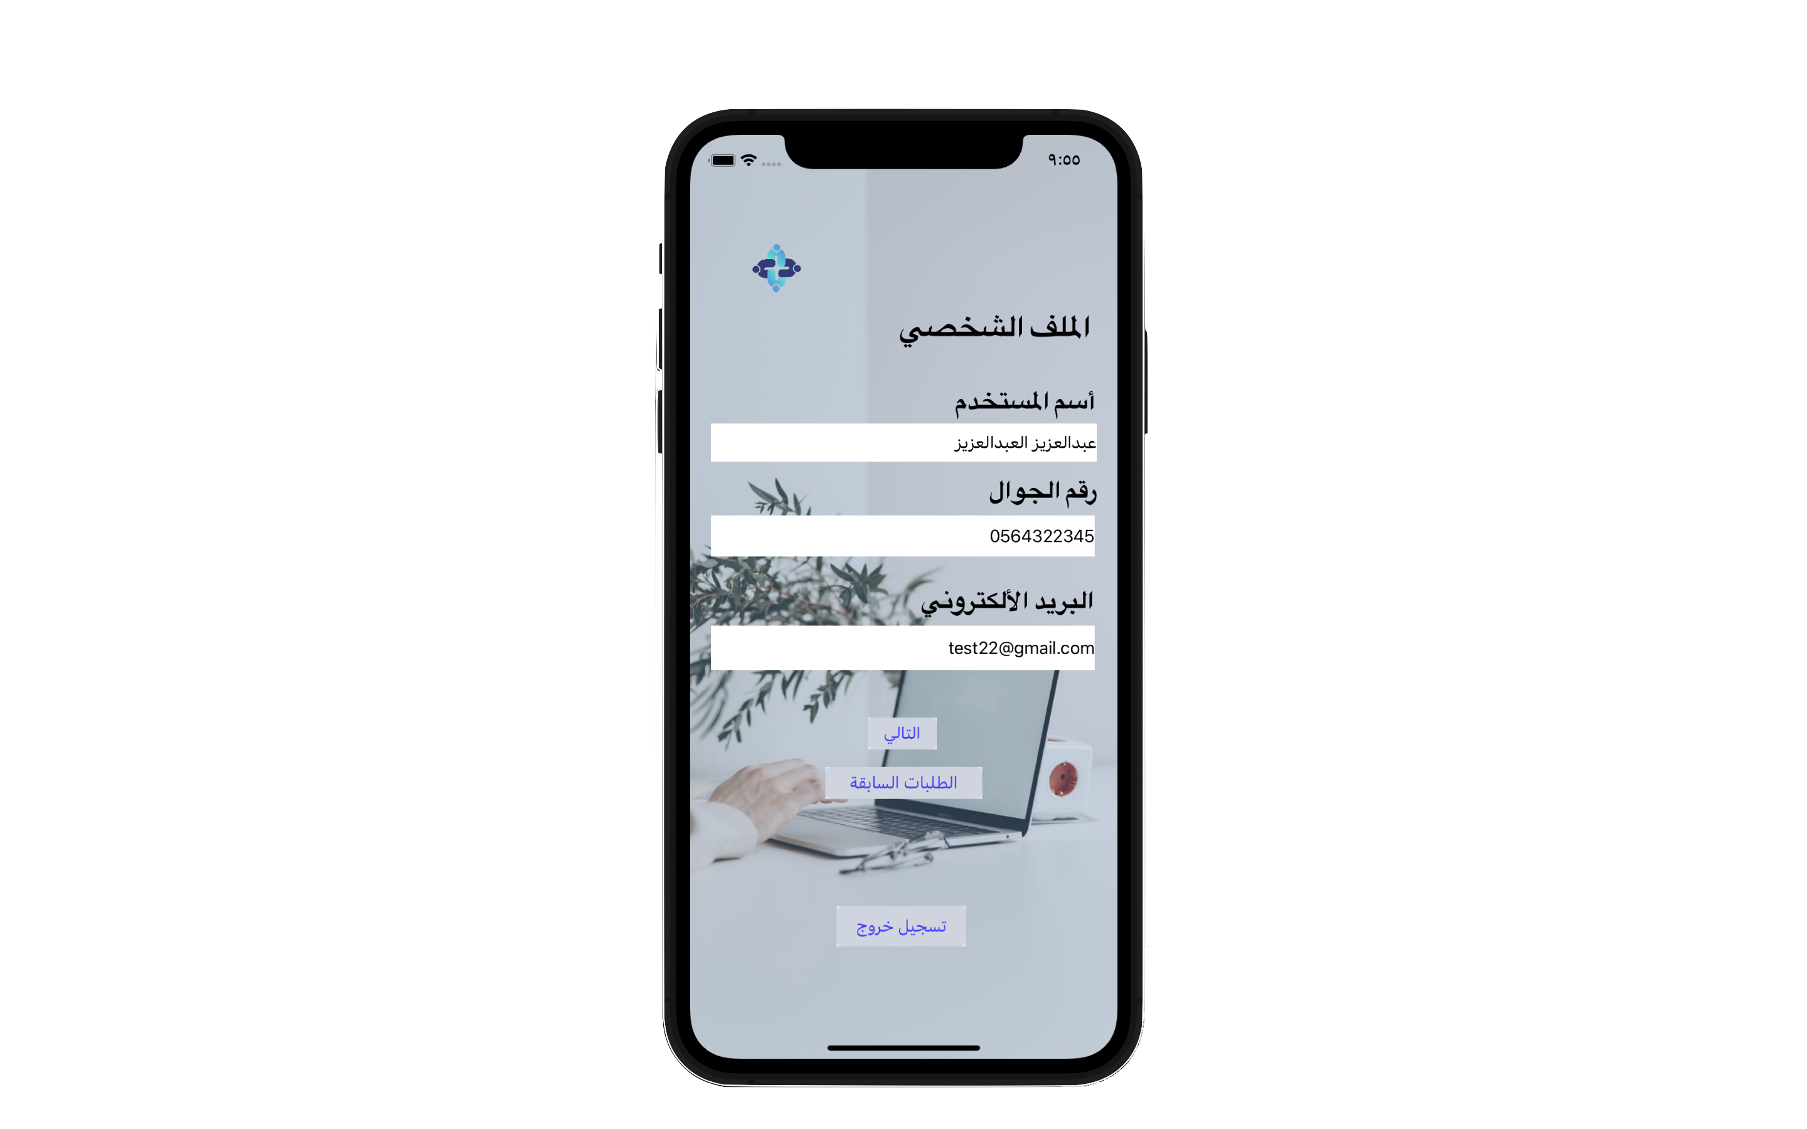
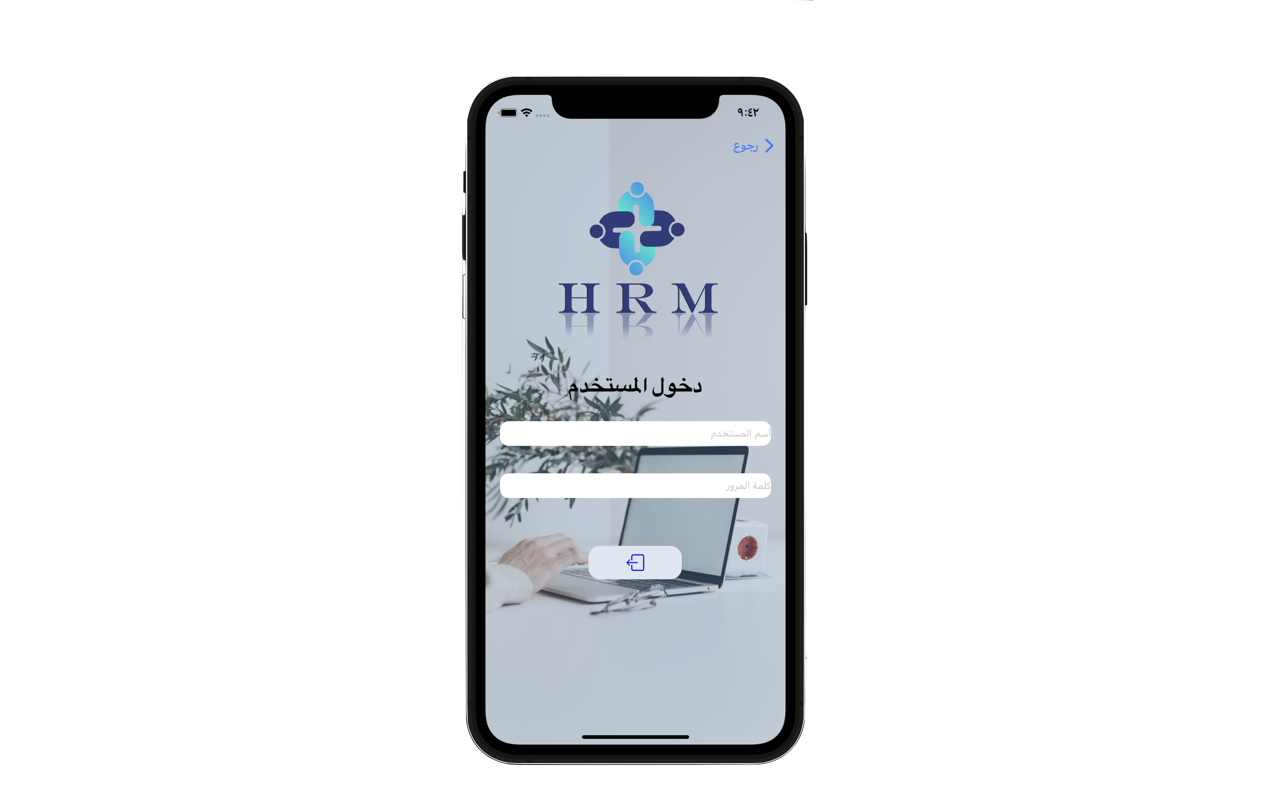
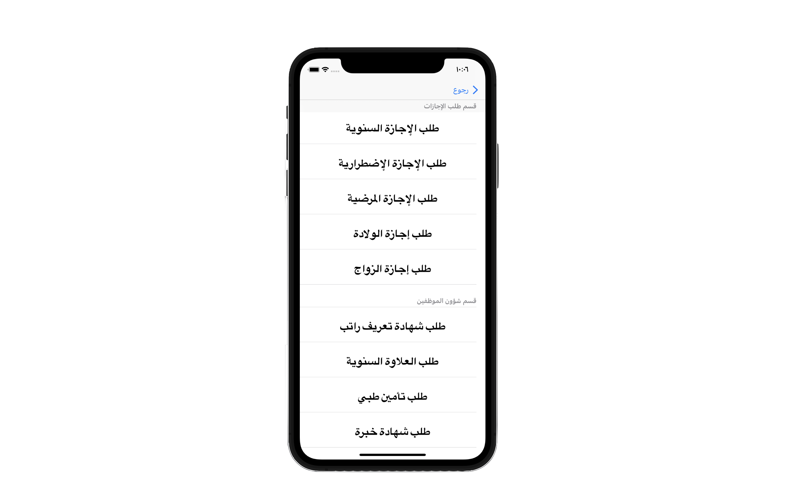
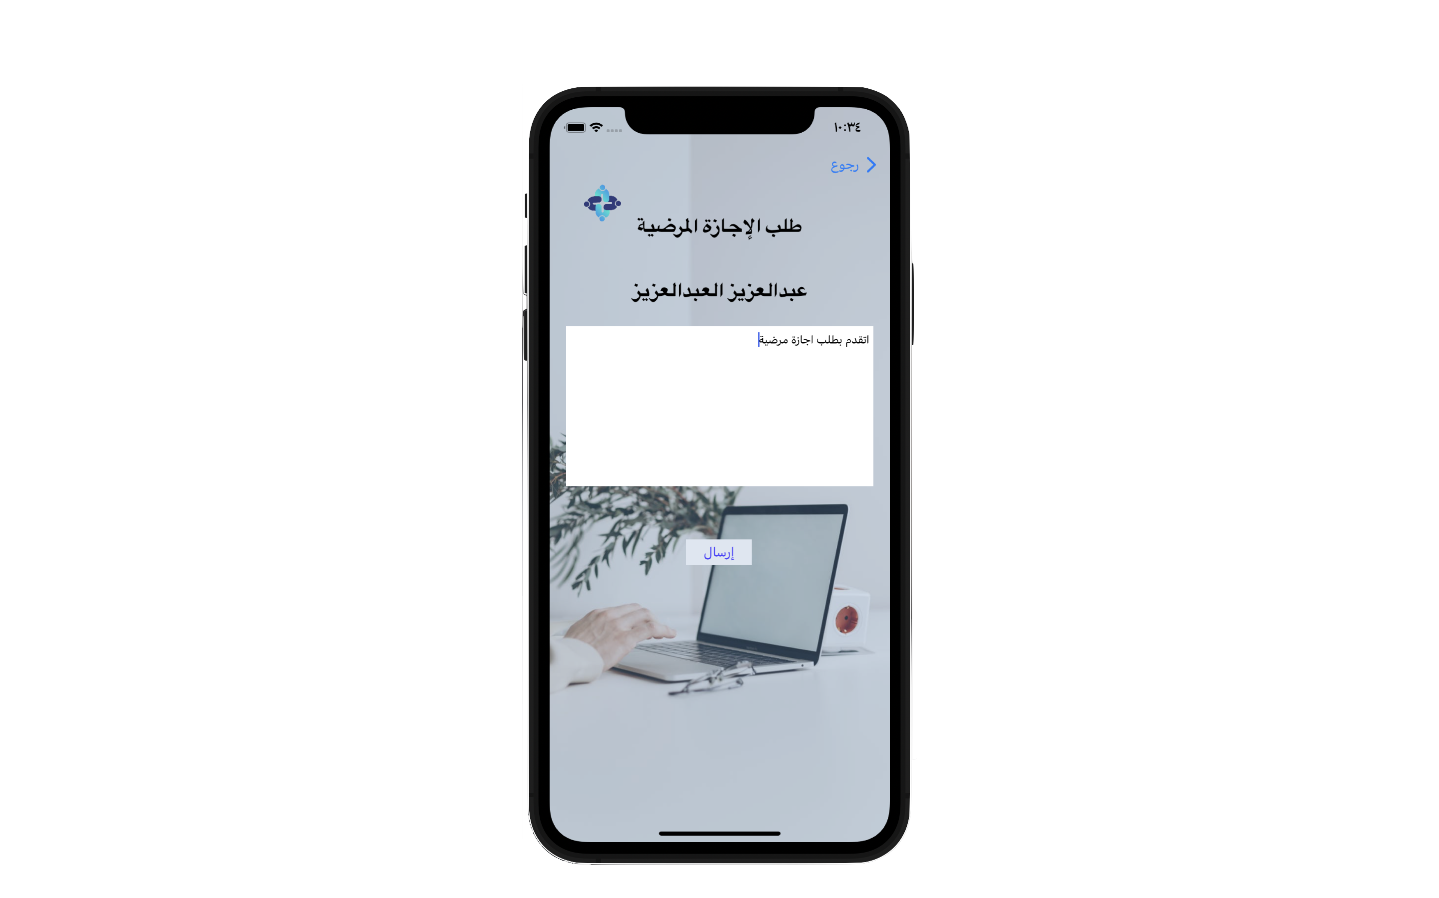
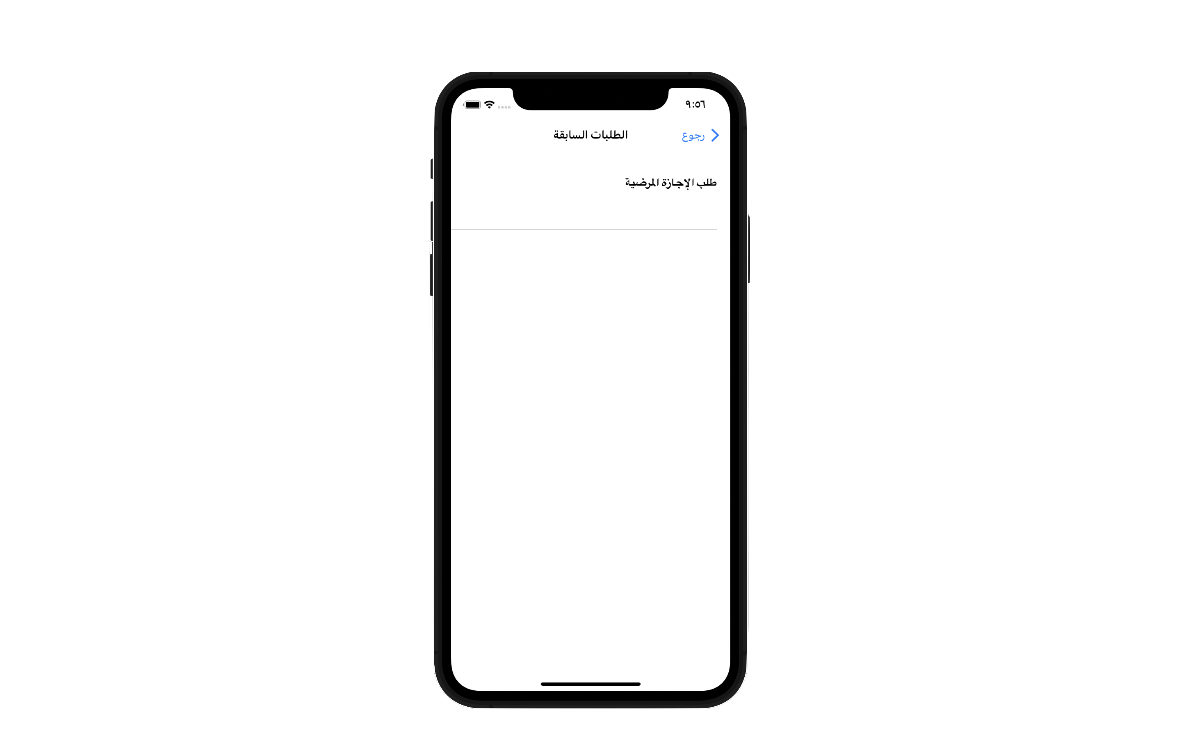
User Story As Employee
- As employee can create new account
- As employee when he join his account .
- As employee he can saw his profile .
- As employee he will see many types of requests .
- employee should be choice one type and write details .
- As employee after doing request , he will send to HR office .

Slide 5
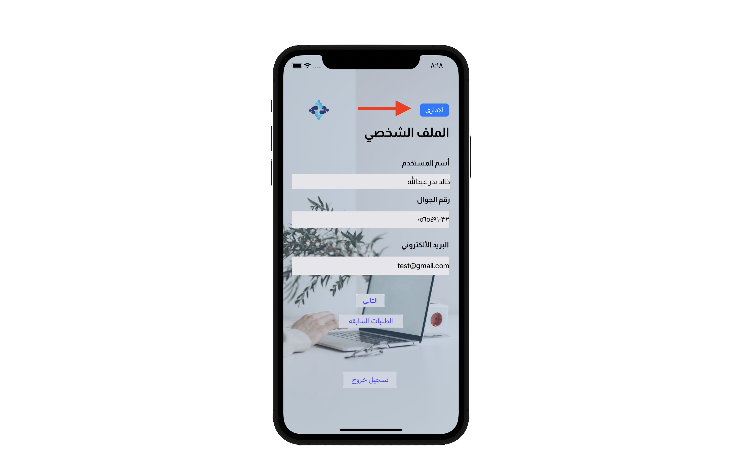
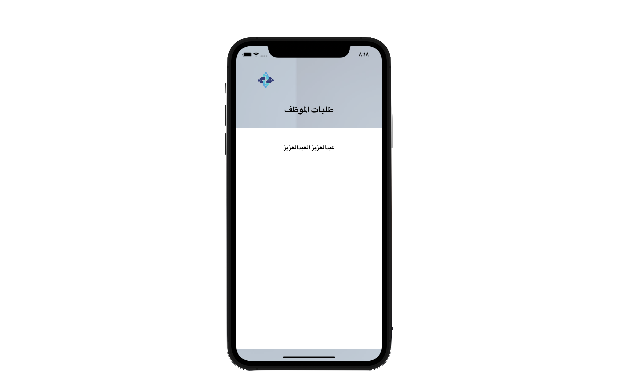
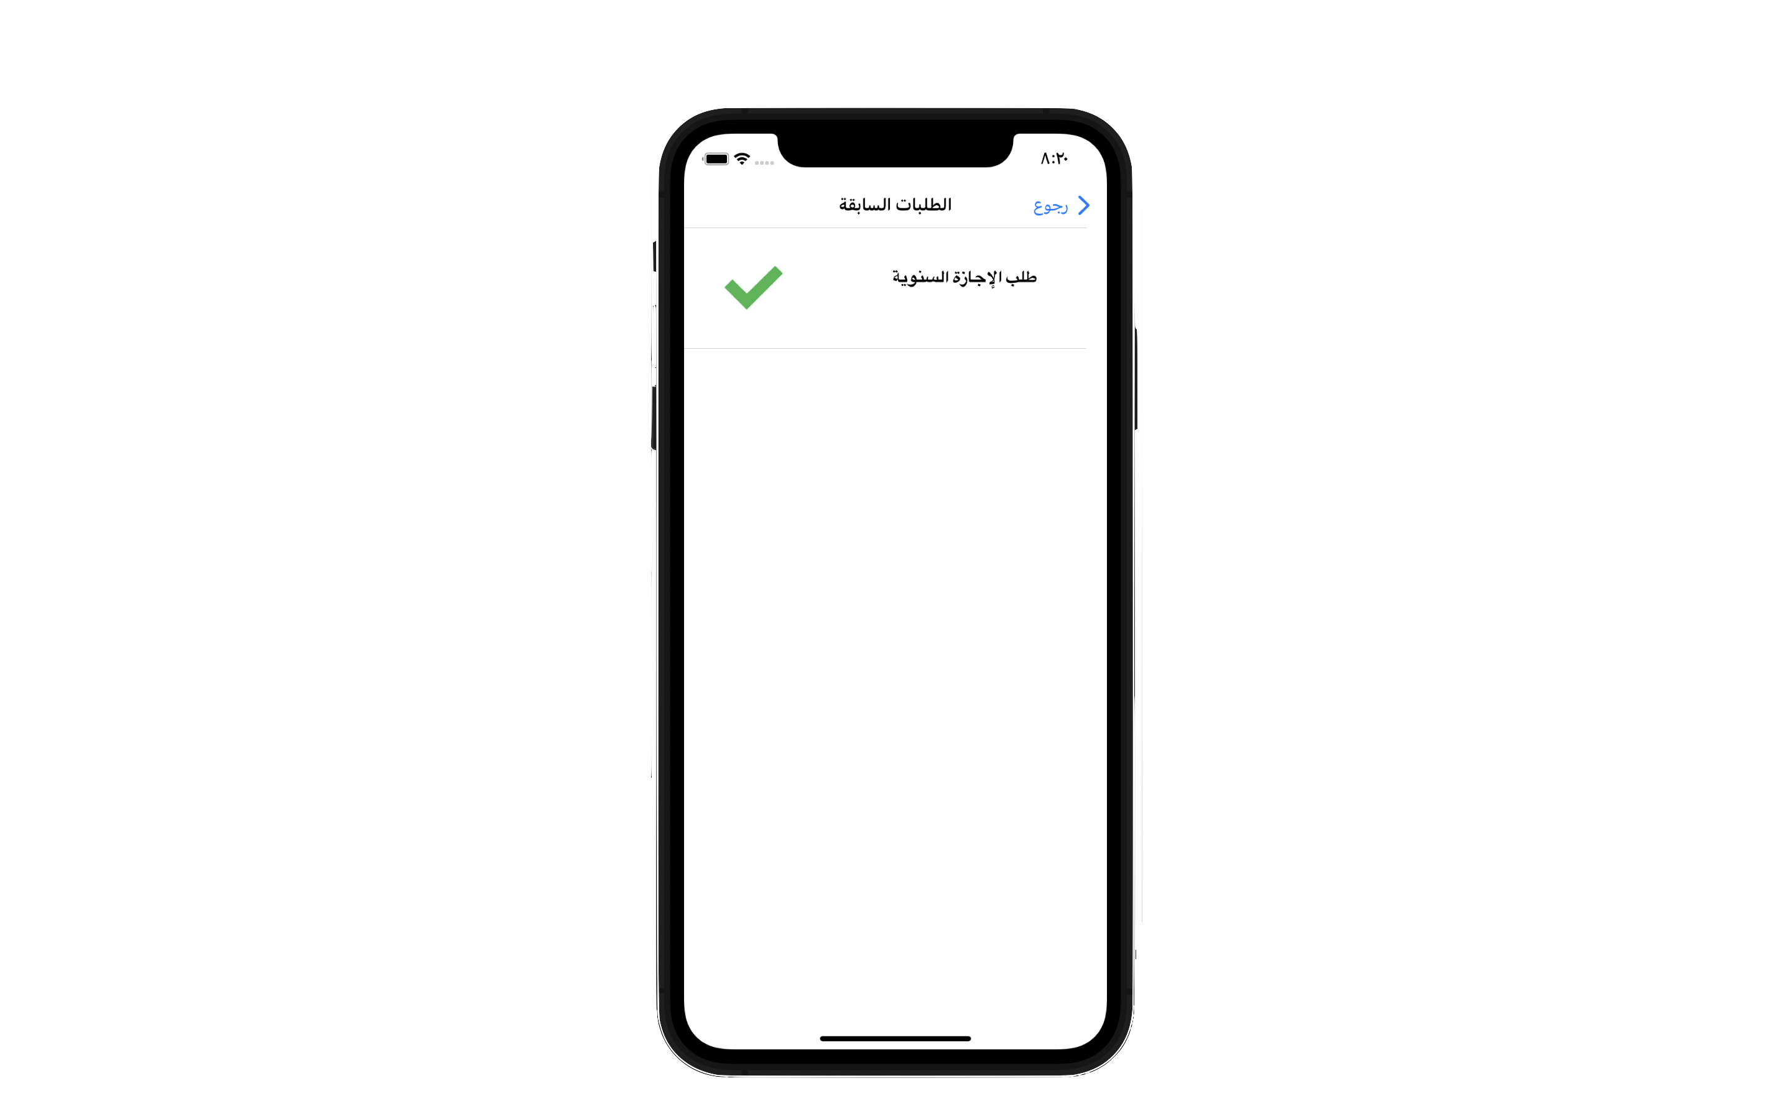
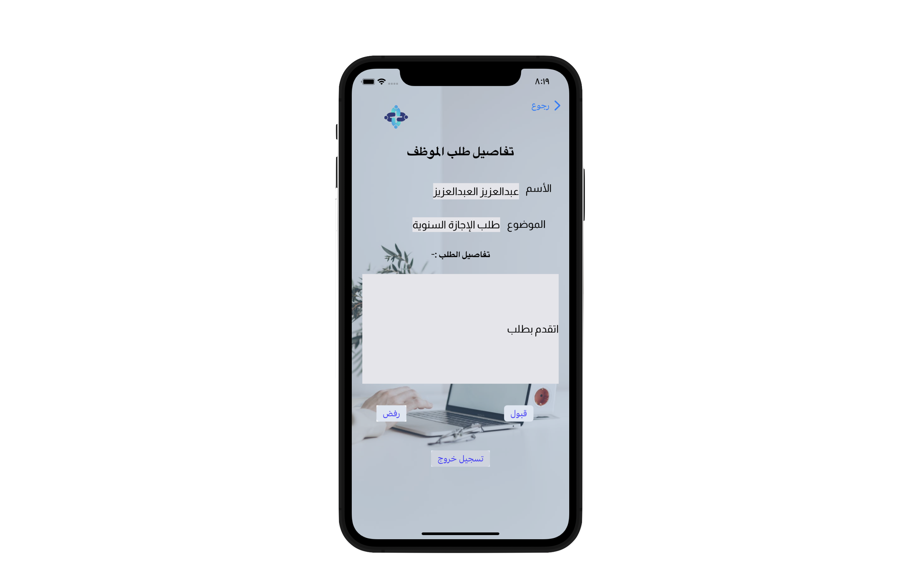
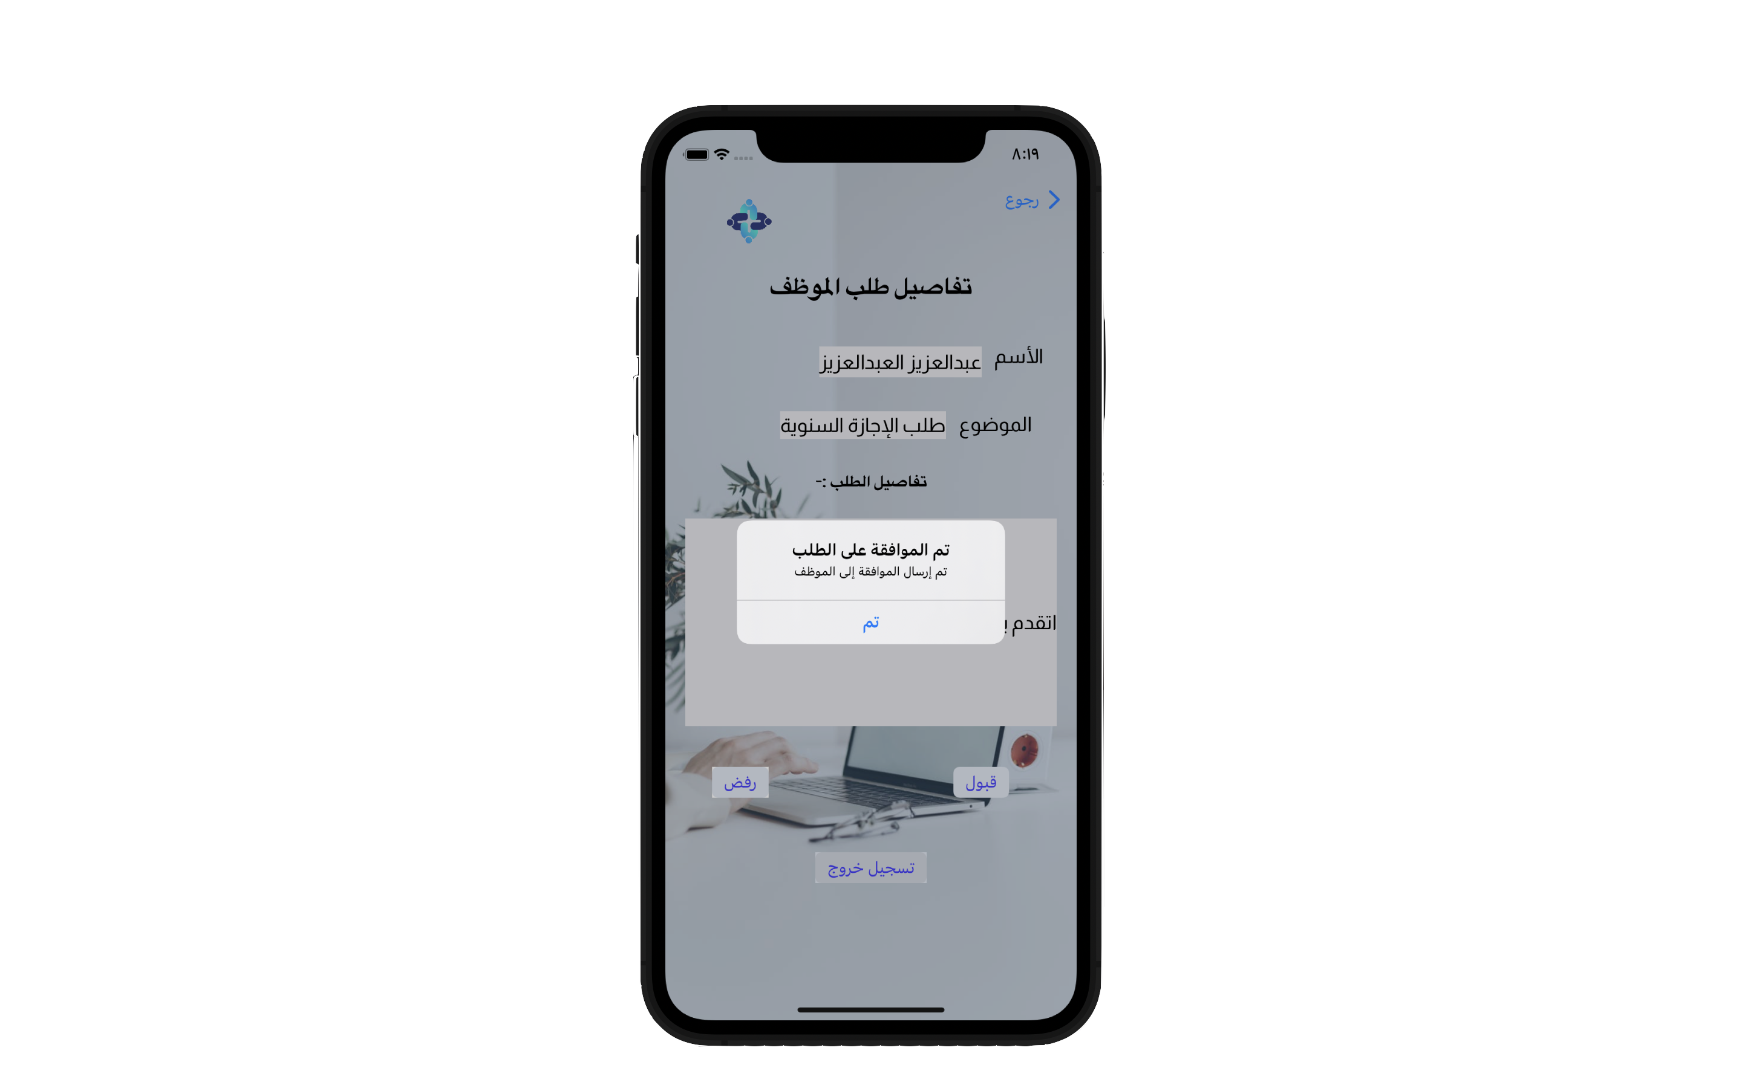
User Story As Manager
- As HR staff can create new account when he add ID manager .
- As HR when he join his account .
- As HR have Manager ID he can check his profile .
- HR office will check all requests of employees .
- HR office give the request a approve or reject .
- As HR when he was rejected or accepted of request , the employee will know when he check his account .

Slide 6
Finally
The program on human resource management in a simple and highly productive way that serves all companies.

Slide 7
Thank You…

